Slide 1

Computer System Servicing

Slide 2
Occupational Health and Safety (OHS)
Occupational Health and Safety (OHS) - is a planned system of working to prevent illness and injury where you work by recognizing and identifying hazards and risks. Health and safety procedure is the responsibility of all persons in the computer and technology industries. You must identify the hazards where you are working and decide how dangerous they are. Eliminate the hazard or modify the risk that it presents.

Slide 3

Occupational Health and Safety (OHS)
1. Do not work alone so that there’s someone who can take care of you in case of emergency.

Slide 4

Occupational Health and Safety (OHS)
2. Always Power Off the computer before working on it.

Slide 5

Occupational Health and Safety (OHS)
3. Take away any liquid near your working area to avoid getting electrocuted or accidentally damaging computer parts.

Slide 6
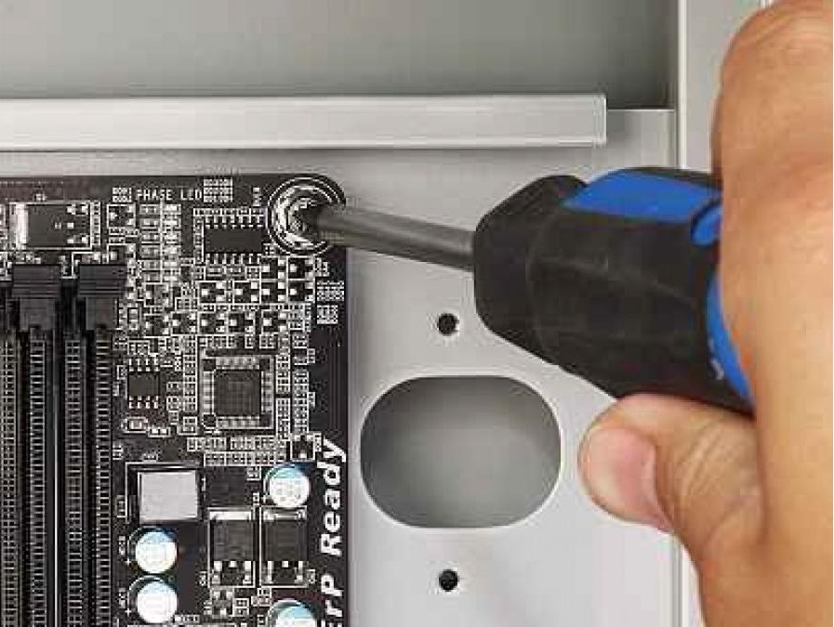
Occupational Health and Safety (OHS)
4. Be careful with tools that may cause short circuit.

Slide 7

Occupational Health and Safety (OHS)
5. Always ground or discharge yourself before touching any parts of the computer.

Slide 8
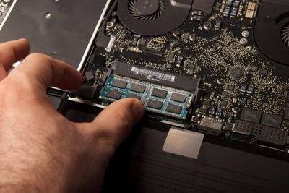
Occupational Health and Safety (OHS)
6. Do not use excessive force if thing don’t quite slip into place.

Slide 9
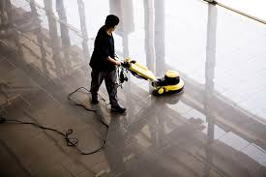
Occupational Health and Safety (OHS)
7. Clean the area before and after using it to maintain sanitation and prevent accidents.

Slide 10
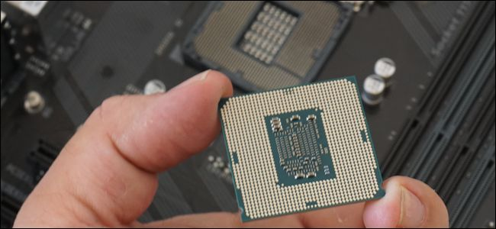
Occupational Health and Safety (OHS)
8. Hold the components on the edges and do not touch the Integrated Circuit (IC).

Slide 11

Occupational Health and Safety (OHS)
9. Always wear personal protective equipment (PPE) in accordance with the organization’s OHS procedures and practices.

Slide 12
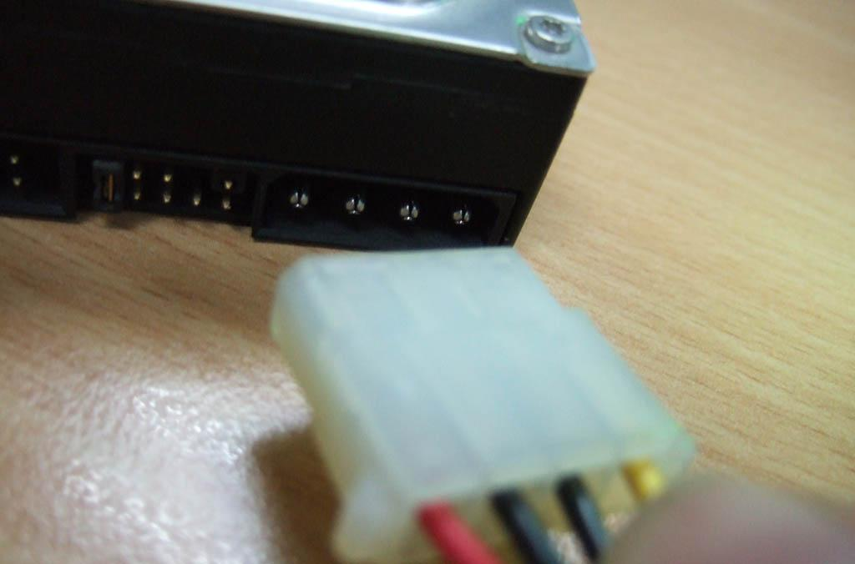
Occupational Health and Safety (OHS)
10. Make sure that the pins are properly aligned when connecting a cable / connector.

Slide 13

Occupational Health and Safety (OHS)
11. Contingency measures during workplace accidents, fire and other emergencies are recognized.

Slide 14
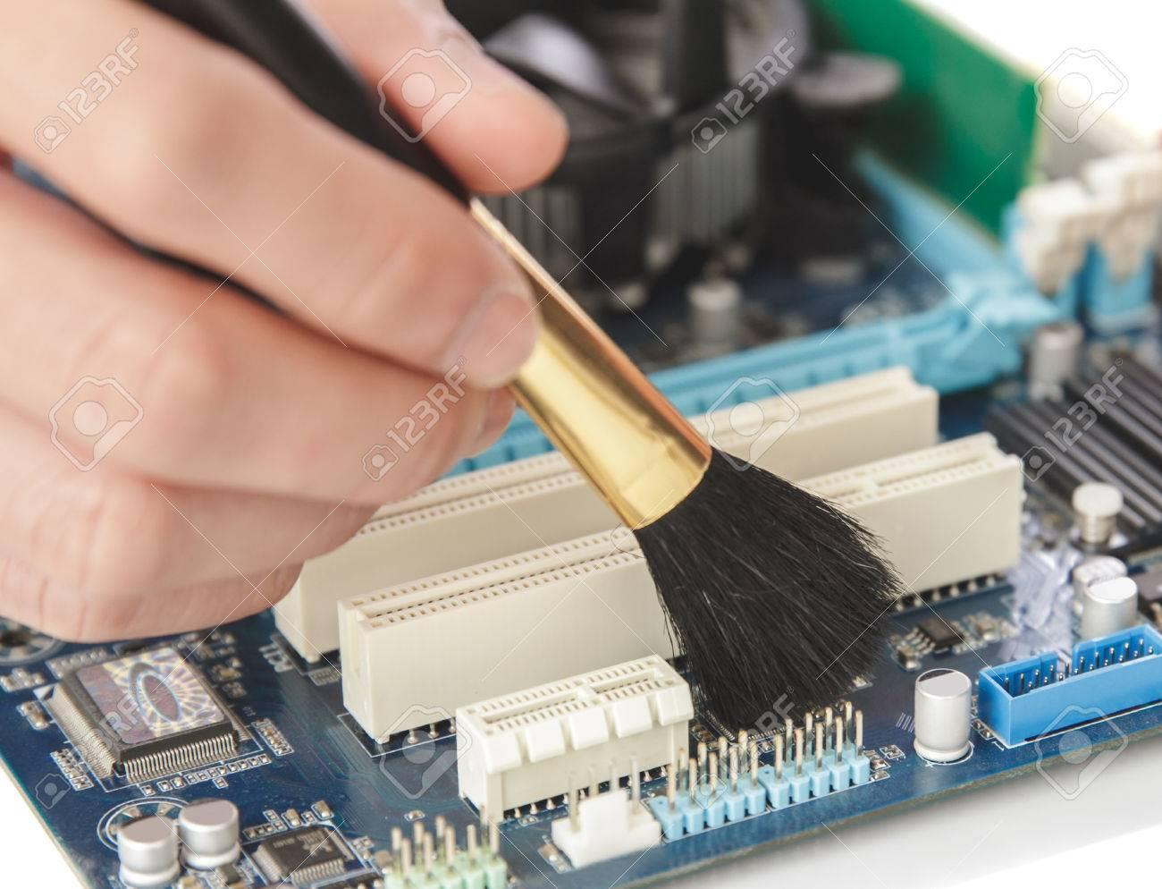
Occupational Health and Safety (OHS)
12. Use brush, compressed air or blower in cleaning the computer system.

Slide 15
Assignment # 1

Slide 16
Direction:
Write at least three (3) household
activities that will lead to an accident
if not properly executed. How this accident will be prevented?

Slide 17
THANK YOU!!!

